Slide 1
Book1
File created on: 5/15/2022 2:51:49 AM

Slide 2


Slide 3
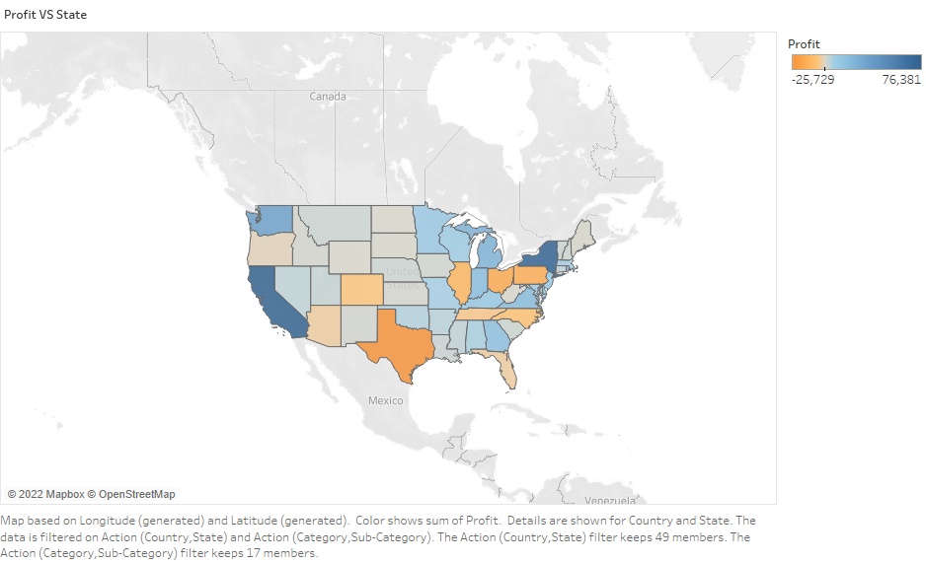

Slide 4
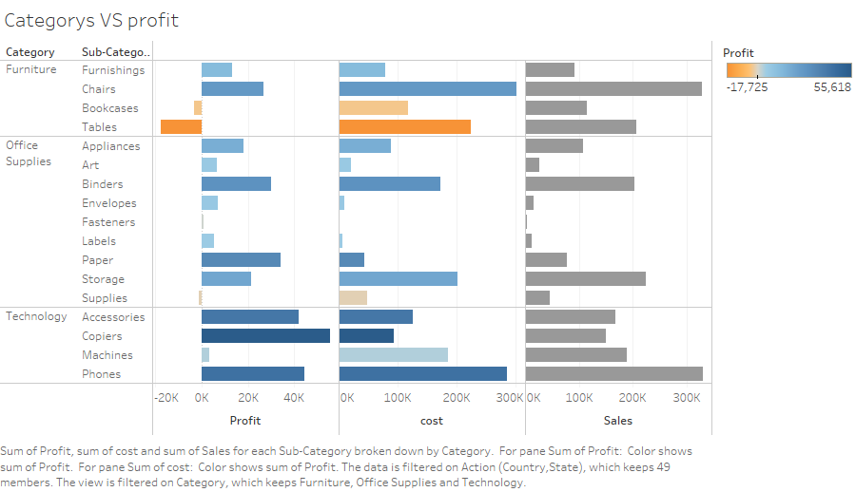

Slide 5
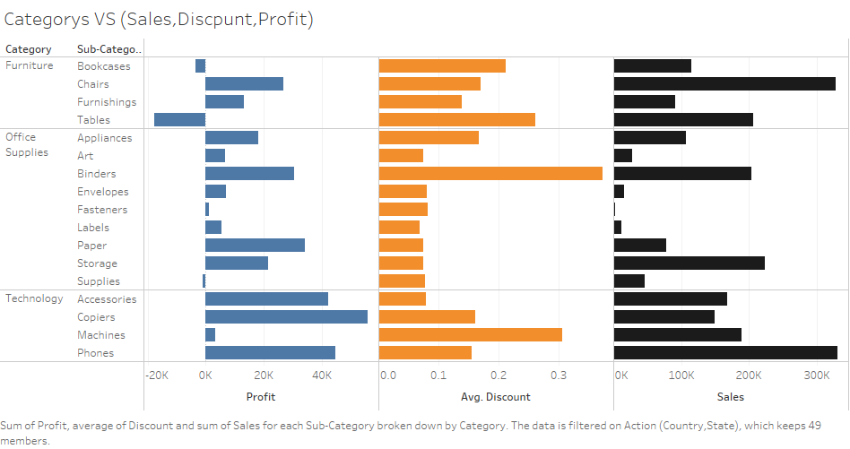

Slide 6
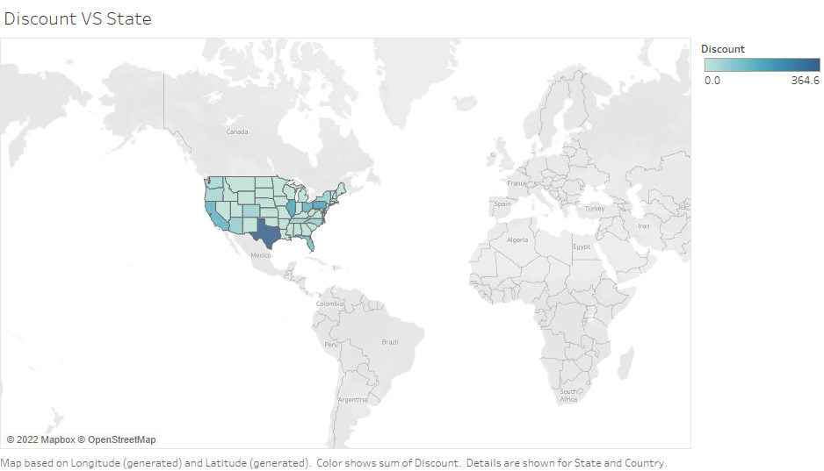

Slide 7
